Slide 1
Legal, Ethical, and Professional Issues in Information Security

Slide 2
Law and Ethics in Information Security
Laws: collection of rules and regulation that mandate or prohibit certain behavior and enforced by the state
Ethics: define socially acceptable behavior
Cultural mores: the fixed moral attitudes or customs of a particular group

Slide 3
Policy Versus Law
Policies: guidelines that describe acceptable and unacceptable employee behaviors in the workplace
policies function as laws: they must be crafted and implemented with the same care to ensure that they are complete, appropriate, and fairly applied to everyone in the workplace
Criteria for policy enforcement:
Dissemination (distribution)
Review (reading)
Comprehension (understanding)
Compliance (agreement)
Uniform enforcement

Slide 4
Types of Law
Civil law: deal with the relationships and conflicts between organizational entities and people
Criminal law: addresses activities and conduct harmful to society
Private law: encompasses family law, commercial law, and labor law, and regulates the relationship between individuals and organizations
Public law: regulates the structure and administration of government agencies and their relationships with citizens, employees, and other governments. Public law includes criminal, administrative

Slide 5
Relevant U.S. Laws
the United States has been a leader in the development and implementation of information security legislation to prevent misuse and exploitation of information and information technology.
The implementation of information security legislation contributes to a more reliable business environment, which in turn, enables a stable economy.

Slide 6
General Computer Crime Laws
Computer Fraud and Abuse Act of 1986 (CFA Act) is the cornerstone of many computer-related federal laws and enforcement efforts
National Information Infrastructure Protection Act of 1996:
modified several sections of the previous act and increased the penalties for selected crimes
The severity of the penalty depends on the value of the information
For purposes of commercial advantage
For private financial gain
In furtherance of a criminal act

Slide 7
General Computer Crime Laws
USA PATRIOT Act of 2001: which provides law enforcement agencies with broader latitude in order to combat terrorism-related activities
Computer Security Act of 1987: It was one of the first attempts to protect federal computer systems by establishing minimum acceptable security practices

Slide 8
Privacy
Individuals and groups right to protect themselves and their personal information from unauthorized access
Aggregate data from multiple sources allow creation of information database that was previously impossible
the number of statutes addressing an individual’s right to privacy has grown
The Privacy of Customer Information Section of the common carrier regulation states that any proprietary information shall be used explicitly for providing services, and not for any marketing purposes, and that carriers cannot disclose this information except when necessary to provide their services

Slide 9
Privacy of Customer Information
Federal Privacy Act of 1974 regulates government agencies and holds them accountable if they release private information about individuals or businesses without permission. The following agencies, regulated businesses, and individuals are exempt from some of the regulations so that they can perform their duties:
Bureau of the Census
National Archives and Records Administration
Federal courts with regard to specific issues using appropriate court orders
Credit reporting agencies
Individuals or organizations that demonstrate that information is necessary to protect the health or safety of that individual
The Electronic Communications Privacy Act of 1986 is a collection of statutes that regulates the interception of wire, electronic, and oral communications.
Health Insurance Portability and Accountability Act Of 1996 (HIPAA): protects the confidentiality and security of health care data by establishing and enforcing standards

Slide 10
Identity Theft
someone uses your personally identifying information, like your name, Social Security number, or credit card number, without your permission to commit fraud or other crimes
Organizations can also be victims of identity theft by means of URL manipulation or DNS redirection
If someone suspects identity theft Federal Trade Commission (FTC) recommends
Place and initial fraud alert: report to the three dominant consumer reporting companies that your identity is threatened so that they may place a fraud alert on your record
Register your concern with the FTC There is a form to register a complaint at the FTC’s identity theft site
if your card is theft close them
Report the incident to either your local police or police in the location where the identity theft occurred

Slide 11
Export and Espionage Laws
The Security and Freedom through Encryption Act of 1999: provides guidance on the use of encryption and provides protection from government intervention. The acts include provisions that:
Reinforce right to use or sell encryption algorithms, without concern of key registration
Prohibit the federal government from requiring the use of encryption
use of encryption is not probable cause to suspect criminal activity
Provide additional penalties for the use of encryption in the commission of a criminal act

Slide 12
U.S. Copyright Law
Intellectual property is a protected asset in the United States
With proper acknowledgement it is permissible to include portions of someone else’s work as reference
Fair use of copyright material includes support teaching, scholarship, educational, library purpose
Financial Reporting: improve the reliability and accuracy of financial reporting, as well as increase the accountability of corporate governance, in publicly traded companies. Penalties for non-compliance range from fines to jail terms.
Freedom of Information Act: allows any person to request access to federal agency records or information not determined to be a matter of national security.
Agencies of the federal government are required to disclose any requested information on receipt of a written request. the act does not apply to state or local government agencies or to private businesses or individuals,

Slide 13
Ethics and information security Offline The Ten Commandments of Computer Ethics
not use a computer to harm other people.
not interfere with other people’s computer work.
not snoop around in other people’s computer files.
not use a computer to steal.
not use a computer to bear false witness.
not copy or use proprietary software for which you have not paid.
not use other people’s computer resources without authorization or proper compensation.
not appropriate other people’s intellectual output.
think about the social consequences of the program you are writing or the system you are designing.
always use a computer in ways that ensure consideration and respect for your fellow humans.

Slide 14
Codes of Ethics and Professional Organizations
professional organizations have established codes of ethics
Codes of ethics can have a positive effect on people’s judgment regarding computer use
responsibility of security professionals to act ethically and according to the policies and procedures of their employers, their professional organizations, and the laws of society

Slide 15
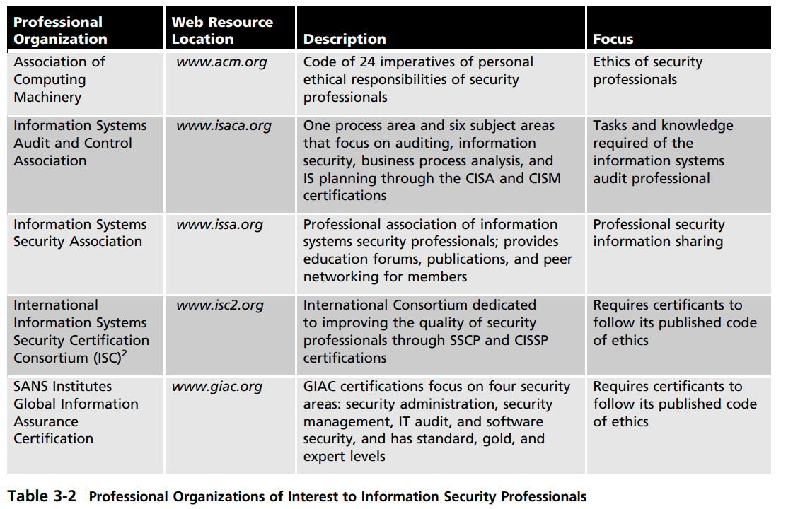
Major IT professional organizations

